Slide 1
Measuring Economic Activity
Aditi Chaubal
(Email: aditi@hss.iitb.ac.in)
HS101 – Economics (Macroeconomics) - 2019

Slide 2
Measuring a Nation’s Income
Recall…
Microeconomics is the study of how individual households and firms make decisions and how they interact with one another in markets.
Macroeconomics is the study of the economy as a whole. Its goal is to explain the economic changes that affect many households, firms, and markets at once.
HS101 – Economics (Macroeconomics) - 2019

Slide 3
Measuring a Nation’s Income
Macroeconomics answers questions such as:
Why is average income high in some countries and low in others?
Why do prices rise rapidly in some time periods while they are more stable in others?
Why do production and employment expand in some years and contract in others?
HS101 – Economics (Macroeconomics) - 2019

Slide 4
Outline
Gross domestic product (GDP)
Elements of GDP
Different ways of measuring GDP
Real vs. Nominal GDP
Major components of GDP
Indian context
Different measures of national output
General price level
Inflation
HS101 – Economics (Macroeconomics) - 2019

Slide 5
The Economy’s Income & Expenditure
A measure of how well an economy is performing is the total income that everyone in the economy is earning.
For an economy as a whole, income must equal expenditure because:
Every transaction has a buyer and a seller.
Every Rupee of spending by some buyer is a Rupee of income for some seller.
The equality of income and expenditure is illustrated with the circular-flow diagram.
HS101 – Economics (Macroeconomics) - 2019

Slide 6
Circular flow of macroeconomic activity (Assumptions)
Oversimplified world
No government
No foreign trade
No investment
Economy produces only consumption goods (i.e. goods purchased by households for personal consumption only)
All goods and services are bought by households
Households spend all their income
2 approaches in terms of:
Flow of products ; Earnings and income approach
HS101 – Economics (Macroeconomics) - 2019

Slide 7
Circular flow of macroeconomic activity
MARKETS
for goods & services
Households buy
Firms sell
Revenue
Spending
Goods & services sold
Goods & services bought
FIRMS
Produce & sell goods and services
Hire & use factors of production
HOUSEHOLDS
Buy and consume goods & services
Own & sell factors of production
MARKETS
for factors of production
Households sell
Firms buy
Factors of production
Labor, land, & capital
Wages, rent, & profit
Income
= Flow of inputs and outputs
= Flow of Rupees
HS101 – Economics (Macroeconomics) - 2019

Slide 8
Equivalence of the 2 approaches
GDP (flow of product approach) (upper loop)
= total money value of the (flow of ) final products produced by the economy ------ I
GDP (flow of earnings/income approach)(lower loop)
= total factor earnings or cost of producing society’s final products ----- II
I = II
Reason: Profits (lower loop) are the residual amount from the sale of a product after other factor costs are paid out.
Wages + Rents + Profits = Income

Slide 9
Value-addition
Flow of products approach includes only final goods (exclude intermediate goods)
Double counting in income approach?
Only the value-added amounts of firms are added while calculating the GDP
Value-added approach => only value-added at each stage of production is included to calculate the GDP
Value added =
Value of the final goods (price of sales which includes the costs incurred owing to factors of production are included)
─ Expenditure on purchase of intermediate goods used to produce the goods
HS101 – Economics (Macroeconomics) - 2019

Slide 10
Gross Domestic Product
Gross domestic product (GDP) is a measure of the income and expenditures of an economy.
GDP is the total market value of all final goods and services (products) produced within a country in a given period of time.
HS101 – Economics (Macroeconomics) - 2019

Slide 11
Defining the Gross Domestic Product
“GDP is the market value. . .”
Output is valued at market prices (which reflect the relative economic value of all the goods and services).
“. . . of all. . .”
Includes all items produced in the economy and sold in markets
“. . . final . . .”
It records only the value of final goods, not intermediate goods (value of intermediate good is included in the price of the final good)
When are intermediate goods considered final goods?
HS101 – Economics (Macroeconomics) - 2019

Slide 12
Defining the Gross Domestic Product
“. . . goods and services . . .”
It includes tangible goods (food, clothing, cars) and intangible services (financial services, transport, health)
“. . . produced . . .”
It includes goods and services currently produced, not transactions involving goods produced in the past.
“ . . . within a country . . .”
It measures the value of production within the geographic confines of a country.
“. . . in a given period of time.”
It measures the value of production that takes place within a specific interval of time, usually a year or a quarter (three months).
HS101 – Economics (Macroeconomics) - 2019

Slide 13
The Components of GDP
GDP includes all items produced in the economy and sold legally in markets.
What is not counted in GDP?
GDP excludes most items that are produced and consumed at home and that never enter the marketplace
It excludes items produced and sold illegally.
Human development indicators: pertaining to poverty, inequality, health and sanitation, etc. in an economy.
HS101 – Economics (Macroeconomics) - 2019

Slide 14
The Components of GDP
Expenditure approach
GDP (Y) is the sum of the following:
Consumption (C)
Investment (I)
Government Purchases (G)
Net Exports (NX)
Y = C + I + G + NX (Identity)
HS101 – Economics (Macroeconomics) - 2019

Slide 15
The Components of GDP…
Consumption (C):
The spending by households on goods and services, with the exception of purchases of new housing. (Health, education, leisure, etc.?)
Investment (I):
The spending on goods (capital equipment, inventories, and structures), including new housing. It consists of additions to the economy’s capital stock (in a year) which is used to produce more goods and services (foregoing current consumption to increase future consumption)
HS101 – Economics (Macroeconomics) - 2019
Notes:
Investments are included in GDP when investors use part of economy’s prodn possibilities for capital formation and not for consumption (upper loop – where final goods and services are purchased)
Invts represent addition to stock of durable capital goods which increase the production possibilities in the future.

Slide 16
The Components of GDP…
Government Purchases (G):
The spending on goods and services by local, state, and central governments. [Expenditure made in exchange for a good or service]
It does not include transfer payments because they are not made in exchange for currently produced goods or services.
Alter a household’s income but do not reflect an economy’s production.
Interest paid by government on debt?
Net Exports (NX) = [Exports – Imports]
Imports are subtracted
Net foreign investment (NFI) =X – IM (when X>IM)
Total Net National Investment (NFI + I)
HS101 – Economics (Macroeconomics) - 2019

Slide 17
Components of GDP in India (Expenditure approach)
(C): Private Final Consumption Expenditure (PFCE)
(G): Government final consumption expenditure (GFCE)
(I): Investment = Gross capital formation (GFC) = [Gross fixed capital formation (GFCF) + Changes in Stock (CIS)] + Valuables
OR
(I): = Gross savings + Net capital inflow from abroad (flow of funds approach)
(X): Exports
(IM): Imports
HS101 – Economics (Macroeconomics) - 2019

Slide 18
Components of GDP in India (Expenditure approach)
PFCE: Expenditure by households and non-profit institutions on non-durable consumer goods and services, and all durable (more than one-year lifetime) goods except land and buildings. Also includes expenditure on rent and imputed rent of owner-occupied buildings/houses.
GFCE: Purchase by central and state government of non-durable goods and services + expenditure on durable goods used for defence. Valuation of collective government services (health, defence, education, justice) : money spent by government to buy the services of the people employed.
HS101 – Economics (Macroeconomics) - 2019

Slide 19
Components of GDP in India (Expenditure approach)
GCF: Consists of the acquisition of fixed assets (machinery, buildings, vehicles) and the accumulation of stocks (raw materials, fuel, finished goods, semi-finished goods). Part of country’s total expenditure NOT consumed but added to economy’s fixed (tangible & intangible) assets and stocks.
Gross domestic investment by private and government sectors + acquisition of residential buildings by households.
GCF = GFCF + CIS + Valuables (commodity flow approach) ---------- (i)
GCF = Gross savings + Net capital inflow from ROW (rest of world) (flow of funds approach) ---------- (ii)
(i) – (ii) = Discrepancies
HS101 – Economics (Macroeconomics) - 2019

Slide 20
Components of GDP in India (Expenditure approach)
G(Fixed)CF = Total value of a producers’ acquisitions
– disposals of fixed assets during the accounting period + additions to value of non-produced assets realized by productive activity of institutional units
Categories of assets included => dwellings, other buildings & structures; machinery & equipment; cultivated biological resources; and intellectual property products.
Changes in stocks (CIS) => change in stock of inventories
Valuables: Expenditure on acquisition of valuables including works of art, precious metals & stones, jewellery.
HS101 – Economics (Macroeconomics) - 2019

Slide 21
Indian GDP (at market prices) and its components for 2018-19 (Base: 2011-12 series)
Components of GDP (Expenditure approach) | Value in Rs crore (at constant prices) Provisional estimates | % share in GDP (%)
PFCE | 8,016,674 | 10.7
GFCE | 1,506,035 | 56.9
GFCF | 4,548,452 | 32.3
CIS | 157,637 | 1.1
Valuables | 174,780 | 1.2
Exports of Goods and Services | 2,933,969 | 20.8
Imports of Goods and Services | 3,557,901 | 25.3
E & O (Discrepancies) | 297,939 | 2.1
GDP | 14,077,586
Source: Annual and quarterly estimates of GDP at constant prices, 2011-12 series (http://mospi.nic.in/data)

Slide 22
The Components of GDP
Income approach
GDP is the sum of the following:
Wages, salaries, other labour income
Interest payments, rent, other property income
Profits
Net taxes (Taxes – Subsidies)
Depreciation: amount of capital used in a year irrespective of whether it replaced old capital or added to the existing stockpile (depicts wear and tear of existing capital)
HS101 – Economics (Macroeconomics) - 2019

Slide 23
Components of GDP in India (Income approach)
GDP = Income generated due to the production activity distributed across 2 factors of production (labour and capital) and the payouts received in terms of salaries and the operating surplus
GDP = GVA @ basic prices + Product taxes – Product subsidies
where
GVA @ basic prices = Compensation of employees (CE) + Gross operating surplus (OS/MI) + (Production taxes – Production subsidies + Consumption of fixed capital (CFC)
GVA: Total value added in terms of the goods and services produced within the economy after accounting for net production taxes and subsidies
HS101 – Economics (Macroeconomics) - 2018

Slide 24
Terminology
Production taxes (or subsidies) are paid (or received) with relation to production and are independent of the volume of actual production.
E.g. Production Taxes - land revenues, stamps and registration fees; Production Subsidies - Subsidies to railways, subsidies to village and small industries
Product taxes (or subsidies) are paid (or received) on per unit of product.
E.g. Product Taxes: excise tax, sales tax, service tax and import and export duties; Product Subsidies: food, petroleum and fertilizer subsidies
HS101 – Economics (Macroeconomics) - 2019

Slide 25
Terminology
Compensation of employees: Total remuneration in cash or in kind payable by employers to employees for the work done. Direct social transfers from employers to their employees or retired employees and their family, such as payments for sickness, educational grants and pensions that do not set up an independent fund, are also imputed in CE.
CFC: Cost of fixed assets used up in production in the accounting period.
Gross operating surplus: It includes interest payable to lenders of financial assets, or rent payable to rentiers of non-produced assets, such as land and sub-soil assets.
GOS = GVA – (CE+CFC+Net of production taxes and subsidies)
HS101 – Economics (Macroeconomics) - 2019

Slide 26
Terminology
Basic prices: The amount receivable by the producer from the purchaser for a unit of a good or service produced as output minus any tax payable, and plus any subsidy receivable, on that unit as a consequence of its production or sale. It excludes any transport charges invoiced separately by the producer.
Producer’s prices: The amount receivable by the producer from the purchaser for a unit of a good or service produced as output minus any VAT, or similar deductible tax, invoiced to the purchaser. It excludes any transport charges invoiced separately by the producer.
Factor cost: When the production and income approach measure GDP in terms of the costs of the factors of production.
Market prices: When the GDP is measured in terms of the market value of goods i.e. in terms of the actual prices which consumers or producers pay for purchase of goods and services (for consumption or investment).
HS101 – Economics (Macroeconomics) - 2018

Slide 27
Components of GDP
Production approach
GDP is calculated based on the different economic activities and capital formation in the economy.
GDP = Total output in the economy i.e. measured as the sum of value-added by all economic activities within the country
Indian context
GDP = GVA at basic prices + Product or Indirect taxes – Product subsidies
Where
GVA @ basic prices = Output (i.e. sum of the value added by all economic activities) – Intermediate consumption
GVA: Total value of output (contribution of labour and capital to production) after discounting intermediate production.
Intermediate consumption: Intermediate consumption consists of the value of the goods and services consumed as inputs by a process of production, excluding fixed assets whose consumption is recorded as consumption of fixed capital (CFC).
HS101 – Economics (Macroeconomics) - 2019

Slide 28
Economic activities included to measure GDP
Agriculture, forestry and fishing
Mining & quarrying
Manufacturing
Electricity, gas, water supply & other utility
services
Construction
Services
Trade, repair, hotels and restaurants
Transport, storage, communication & services related to broadcasting
Financial services
Real estate, ownership of dwelling and
professional services
Public administration and defence
Other services
HS101 – Economics (Macroeconomics) - 2019

Slide 29
Different measures of national output
Net Domestic Product (NDP)
NDP = GDP – Depreciation
Gross National Product (GNP)
GNP = GDP + Income earned by Indians abroad
– Income earned by foreigners in India
Net national Product (NNP)
NNP = GNP - Depreciation
HS101 – Economics (Macroeconomics) - 2019

Slide 30
Different measures of national output
National Income (NI): Total income received by the factors of production (labour, capital and land) called factor incomes. Payments for which no goods or services are received in return are termed transfer payments. Other incomes such as pensions, education grants, unemployment benefits, etc. are paid out of factor incomes and are called transfer incomes.
NI = GDP – Depreciation – Indirect taxes
Personal Disposable Income (DI): It is a measure of amount of the money in the hands of the individuals and available for their consumption or savings.
DI = NI – direct taxes – (profits – dividends) + transfer payments
= NI – direct taxes – (Net business savings) + transfer payments
HS101 – Economics (Macroeconomics) - 2019

Slide 31
Real vs. Nominal GDP
Nominal GDP values the production of goods and services at current prices or actual market prices.
Current prices change over time
Inflation: Rate of growth of the price level from one year or month to the next.
Deflation vs. disinflation
Issue: Measuring GDP using changing prices
If GDP changes from T₁ to T₂, it could be due to:
Larger volume of goods & services produced
OR
Higher prices of goods and services
HS101 – Economics (Macroeconomics) - 2019

Slide 32
Real vs. Nominal GDP
Need for a price-invariant measure of total quantity of goods and services.
Real GDP values the production of goods and services at constant prices.
Measures value of goods & services produced in the economy at prices prevailing in the past.
Reflects changes in quantities being produced (after accounting for price changes), and the economy’s ability to supply people’s needs.
HS101 – Economics (Macroeconomics) - 2019

Slide 33
GDP Deflator
Difference between nominal GDP and real GDP (or the price of GDP)
Measure of overall price levels in the economy
Measures how much of a rise in nominal GDP is attributable to a rise in prices rather than a rise in the quantities produced
Measures current level of prices relative to level of prices in the reference base year
HS101 – Economics (Macroeconomics) - 2019

Slide 34
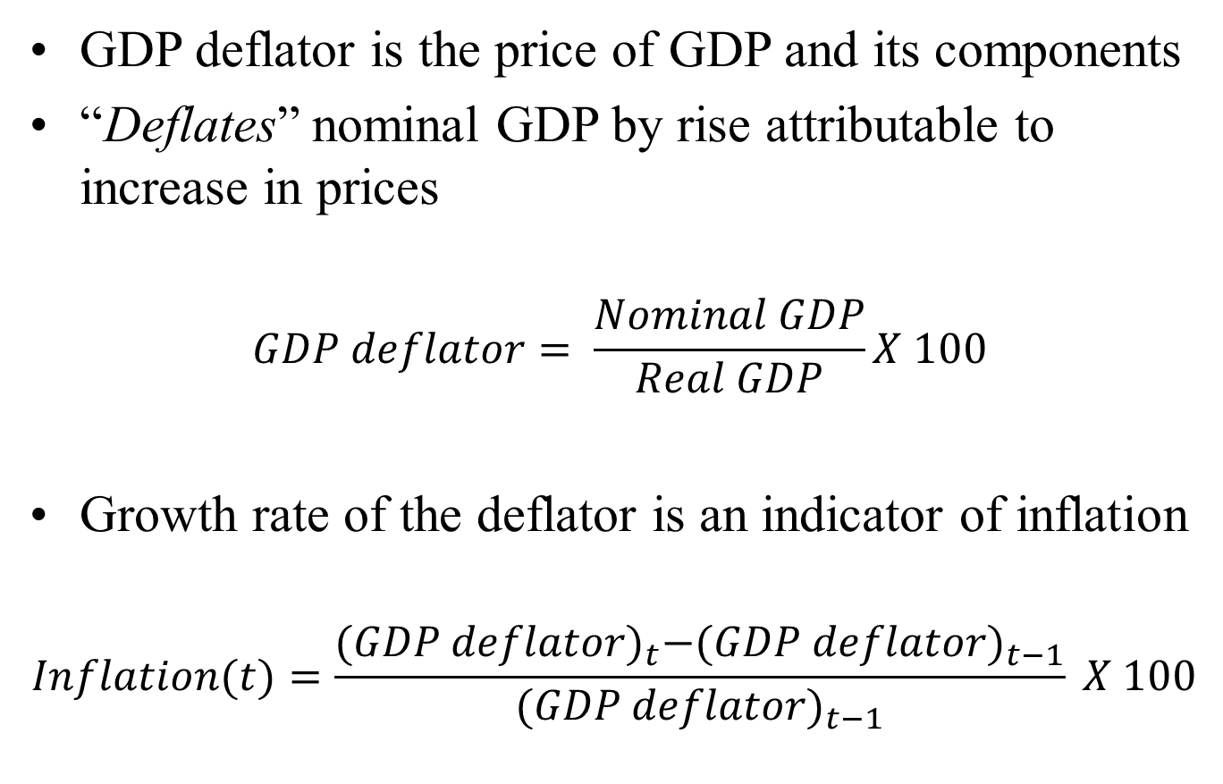
GDP Deflator
GDP deflator is the price of GDP and its components
“Deflates” nominal GDP by rise attributable to increase in prices
$$GDP deflator= \frac{Nominal GDP}{Real GDP}X 100$$
Growth rate of the deflator is an indicator of inflation
$$Inflation(t)=\frac{{(GDP deflator)}_{t}−{(GDP deflator)}_{t−1}}{{(GDP deflator)}_{t−1}} X 100$$
HS101 – Economics (Macroeconomics) - 2019

Slide 35
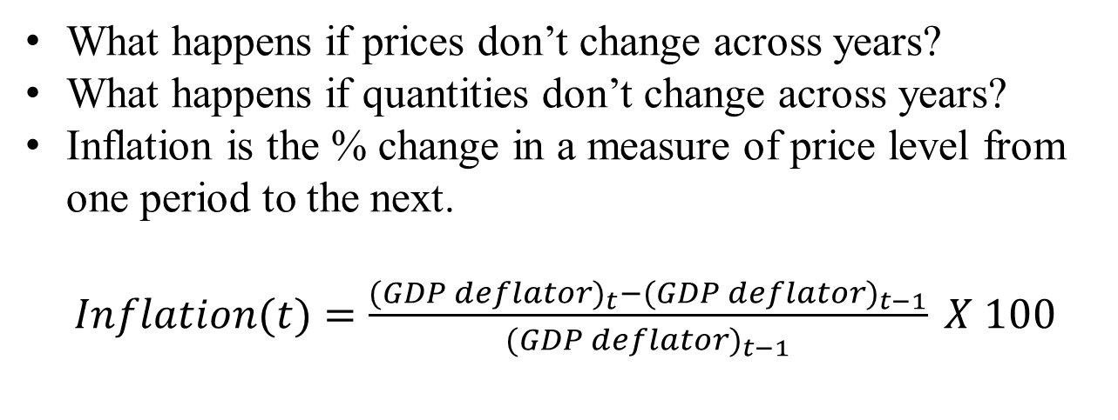
Calculating Nominal and Real GDP
Year | Prices (Rs) |  | Quantity (Number) |  | Nominal GDP (Rs.) | Real GDP (2015 prices) (Rs.) | GDP Deflator
 | Pen | Notebook | Pen | Notebook
2015 | 10 | 40 | 500 | 1500 | 65000 | 65000 | 100
2016 | 12 | 50 | 1000 | 2000 | 112000 | 90000 | 124
2017 | 15 | 70 | 1800 | 3000 | 237000 | 138000 | 172
What happens if prices don’t change across years?
What happens if quantities don’t change across years?
Inflation is the % change in a measure of price level from one period to the next.
$Inflation(t)=\frac{{(GDP deflator)}_{t}−{(GDP deflator)}_{t−1}}{{(GDP deflator)}_{t−1}} X 100$
HS101 – Economics (Macroeconomics) - 2019

Slide 36
Identity of Savings and Investment
Domestic investment and net exports constitute the investment of an economy
National savings constitute private savings and government’s budget surplus
Introduce government, trade and business savings
Domestic investment + Net exports
=
Private savings + budget surplus
HS101 – Economics (Macroeconomics) - 2019

Slide 37
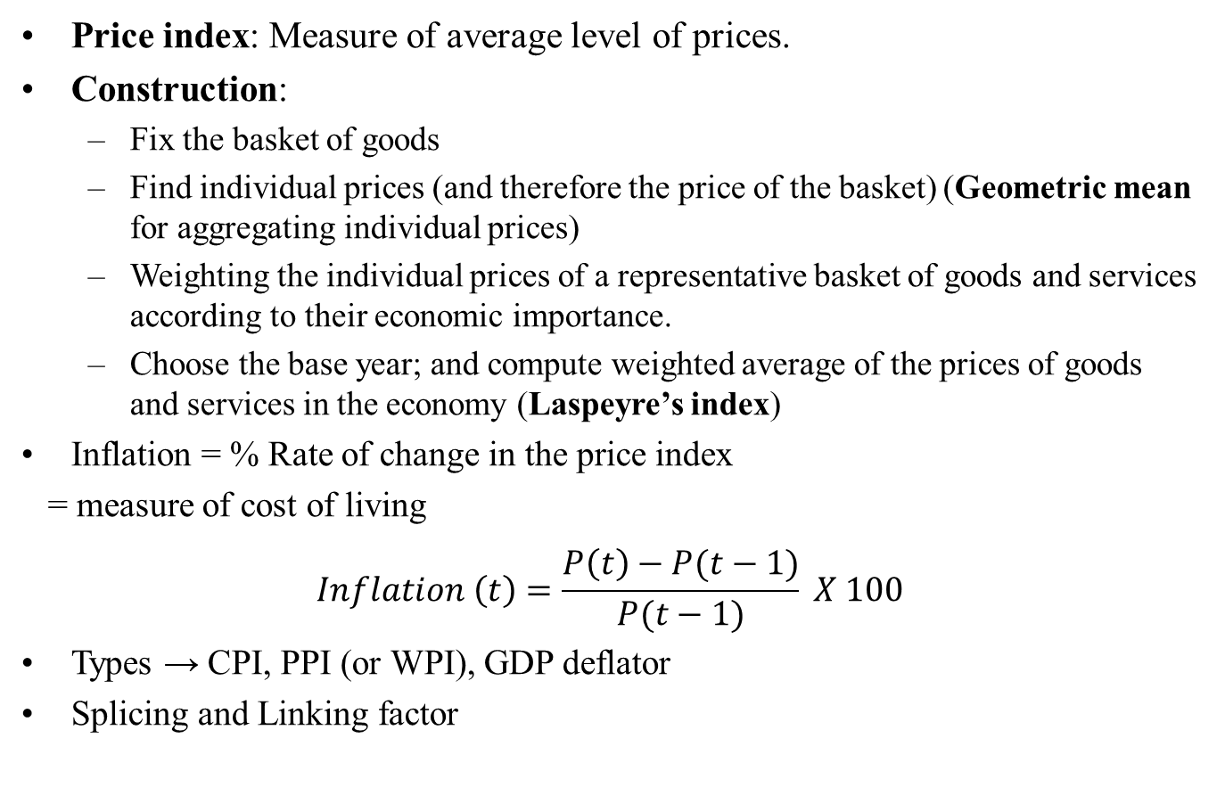
Price indices and Inflation
Price index: Measure of average level of prices.
Construction:
Fix the basket of goods
Find individual prices (and therefore the price of the basket) (Geometric mean for aggregating individual prices)
Weighting the individual prices of a representative basket of goods and services according to their economic importance.
Choose the base year; and compute weighted average of the prices of goods and services in the economy (Laspeyre’s index)
Inflation = % Rate of change in the price index
= measure of cost of living
$$Inflation \left(t\right)=\frac{P\left(t\right)−P(t−1)}{P(t−1)} X 100$$
Types → CPI, PPI (or WPI), GDP deflator
Splicing and Linking factor
HS101 – Economics (Macroeconomics) - 2019

Slide 38
Consumer Price Index (CPI)
It measures the overall cost of the goods and services bought by the consumer
Consumer Price Index (CPI) measures the cost of buying a representative basket of goods and services at different points in time.
Widely used as a macroeconomic indicator of inflation and for monitoring price stability
Tool for governments and central banks for inflation targeting
Also used as GDP deflator in the national accounts.
Issues with CPI: Not a perfect measure of the cost of living.
Substitution bias: disproportionate change in prices (and consumption) of commodities.
Introduction of new goods not included
Unmeasured quality changes
HS101 – Economics (Macroeconomics) - 2019

Slide 39
CPI in India
Indian context:
24 groups of goods and services constitute the representative basket
Food & beverages (45.86%) ; Pan, tobacco & intoxicants (2.38%); Clothing & footwear (6.53%) ; Housing (10.07 %); Fuel & light (6.84%); Miscellaneous (28.32%)
Monthly price data are collected from 1114 markets in 310 selected towns by the Field Operations Division of NSSO and the specified State/UT Directorates of Economics and Statistics and from 1181 selected villages by the Department of Posts.
Importance of CPI in India:
People more conscious of changes in prices of goods & services they consume and the impact on their cost of living
Inflation target
Adjustment factor for indexation of wages, salaries, etc.
Estimation of cost of living
Types of CPI : CPI-UNME, CPI-IW, CPI-AL/RL
HS101 – Economics (Macroeconomics) - 2019

Slide 40
Producer Price Index (PPI)
Measures level of prices at wholesale level (producer stage) or point of bulk sale i.e. measures cost if basket of goods & services bought by the firms rather than households
Weighting is done by using the net sales of each commodity as fixed weights
HS101 – Economics (Macroeconomics) - 2019

Slide 41
WPI – Indian context
Indian context (DIPP, Office of Economic Adviser)
Total of 697 commodities in the representative basket
3 broad categories: primary articles, fuel & power, manufactured products
Primary articles: food, non-food, minerals
Fuel & power: coal, mineral oils, electricity and crude petroleum
Manufactured products: 22 sub-groups
Exclude the indirect taxes to conform with global PPI measures
Weights:
Based on total transactions in the economy
Top-down approach where the weights are calculated as the share of the commodity in the net traded value (NTV) (NTV =Output – NX)
Computation:
Prices for individual commodities aggregated as arithmetic mean
Laspeyre’s index for aggregation across basket
HS101 – Economics (Macroeconomics) - 2019

Slide 42
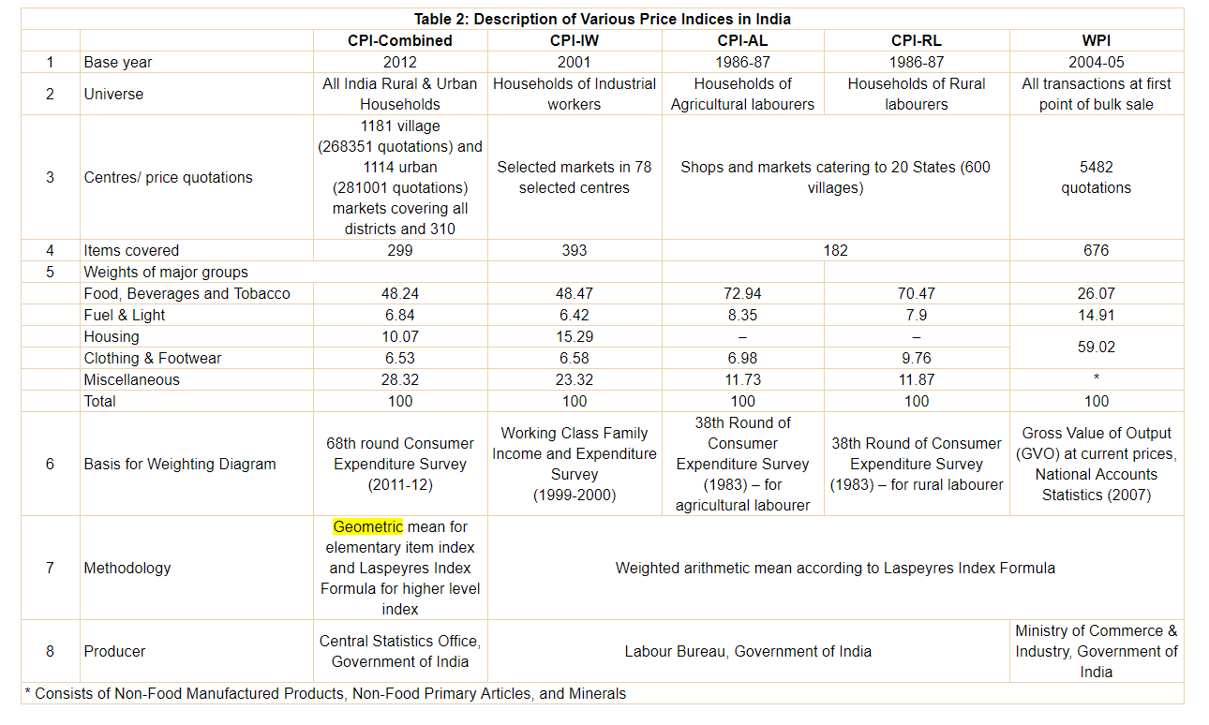
Summary of Indian CPI and WPI
Ref: Das & George (2017): Comparison of Consumer and Wholesale Prices Indices in India: An Analysis of Properties and Sources of Divergence, RBI Working Paper Series No. 5

Slide 43
Price indices and inflation
Inflation vs. deflation (What is disinflation?)
Issues:
Choice of base year
Choice of the representative basket of goods
Biases in the indices: upward bias in price, overestimating growth
HS101 – Economics (Macroeconomics) - 2019

Slide 44
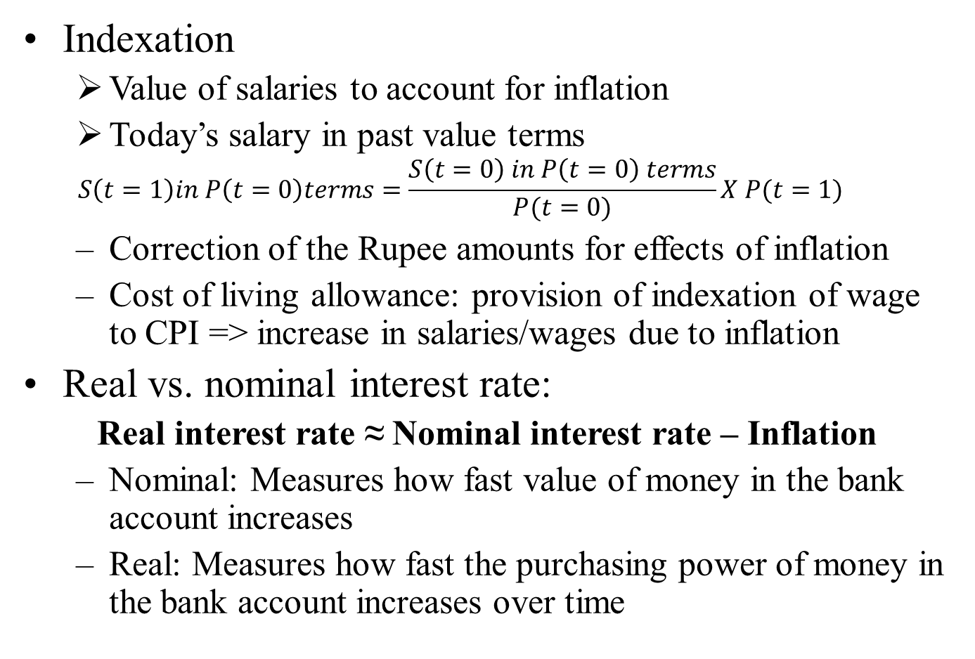
Additional concepts
Indexation
Value of salaries to account for inflation
Today’s salary in past value terms
$$S\left(t=1\right)in P\left(t=0\right)terms=\frac{S\left(t=0\right) in P\left(t=0\right) terms}{P(t=0)}X P(t=1)$$
Correction of the Rupee amounts for effects of inflation
Cost of living allowance: provision of indexation of wage to CPI => increase in salaries/wages due to inflation
Real vs. nominal interest rate:
Real interest rate ≈ Nominal interest rate – Inflation
Nominal: Measures how fast value of money in the bank account increases
Real: Measures how fast the purchasing power of money in the bank account increases over time
HS101 – Economics (Macroeconomics) - 2019

Slide 45
Thank you
HS101 – Economics (Macroeconomics) - 2019

